Slide 1
Law and Elasticity of Supply
HS201

Slide 2
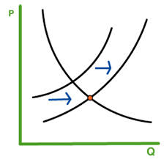
What is Supply ?
Supply is defined as the quantity of a product that a producer is cable in supplying at a given price and time.

Slide 3
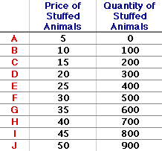
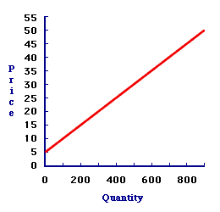
The Law of Supply
price and quantity supplied is directly related in the Law of Supply
  With a rise in the price of a product , producers will be willing to supply more.
  The minimum price necessary to induce producers to supply next unit to market.
  B. opportunity cost of producing the next unit of the good.

Slide 4
The Law of Supply
The law of supply is accounted for by two factors:
  When prices rise, firms substitute production of one good for another.
  Assuming firms’ costs are constant, a higher price means higher profits.

Slide 5
The Supply Curve
The supply curve is the graphic representation of the law of supply.
The supply curve slopes upward to the right.
The slope tells us that the quantity supplied varies directly – in the same direction – with the price.

Slide 6
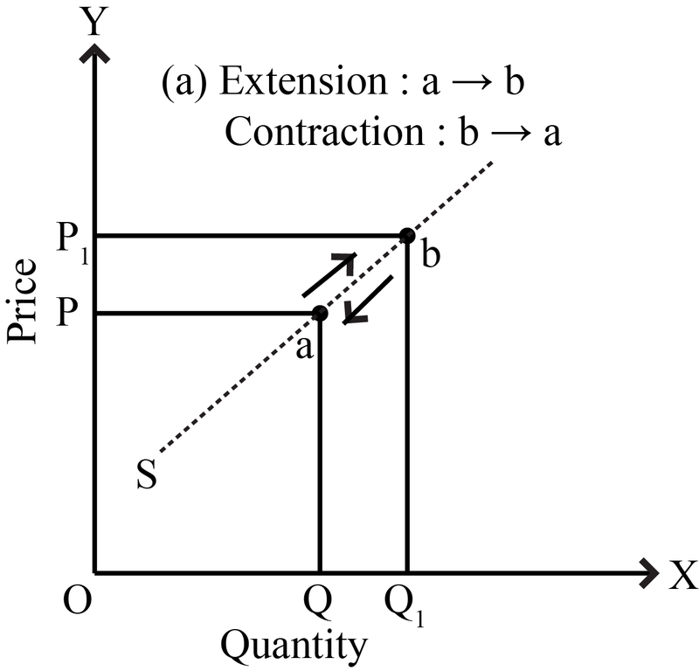
Supply Curve

Slide 7
Shifts in Supply Versus Movements Along a Supply Curve
Supply refers to a schedule of quantities a seller is willing to sell per unit of time at various prices, other things constant.
Quantity supplied refers to a specific amount that will be supplied at a specific price.
Changes in price causes changes in quantity supplied represented by a movement along a supply curve.
A movement along a supply curve – the graphic representation of the effect of a change in price on the quantity supplied.

Slide 8
Change in Quantity Supplied
S₀
B
Price (per unit)
Change in quantity supplied (a movement along the curve)
A
$15
1,250
1,500
Quantity supplied (per unit of time)

Slide 9
Shift in Supply
S₀
S₁
Price (per unit)
A
B
$15
Shift in Supply
(a shift of the curve)
1,250
1,500
Quantity supplied (per unit of time)

Slide 10
Factors of Shift in Supply
Other factors besides price affect how much will be supplied:
  Prices of inputs used in the production of a good.
  Technology.
  Suppliers’ expectations.
  Taxes and subsidies.

Slide 11
Factors that Shift Supply
Resource
Prices
Prices of Related
Goods and Services
Technology
And
Productivity
Supply
Number
Of
Producers
Expectations
Of
Producers

Slide 12

Determinates of Supply
Expectations
When costs go up, profits go down, so that the incentive to supply also goes down.
Advances in technology reduce the number of inputs needed to produce a given supply of goods.
Costs go down, profits go up, leading to increased supply.
If suppliers expect prices to rise in the future, they may store today's supply to reap higher profits later.

Slide 13

Number of Suppliers
As more people decide to supply a good the market supply increases (Rightward Shift).
The market supply curve is derived by horizontally adding the individual supply curves of each supplier.

Slide 14
From Individual Supplies to a Market Supply
(1)
(2)
(3)
(4)
(5)
Quantities
Price
Ann's
Barry's
Charlie's
Market
Supplied
(per DVD)
Supply
Supply
Supply
Supply
A
B
C
D
E
F
G
H
I
$0.00
0.50
1.00
1.50
2.00
2.50
3.00
3.50
4.00
0
1
2
3
4
5
6
7
8
0
0
1
2
3
4
5
5
5
0
0
0
0
0
0
0
2
2
0
1
3
5
7
9
11
14
15

Slide 15
From Individual Supplies to a Market Supply
Charlie
Barry
Ann
Market Supply
$4.00
I
3.50
H
3.00
G
2.50
F
Price per DVD
2.00
E
1.50
D
1.00
C
0.50
B
C_{A}
0
A
1 2 3 4 5 6 7 8 9 10 11 12 13 14 15 16
Quantity of DVDs supplied (per week)

Slide 16
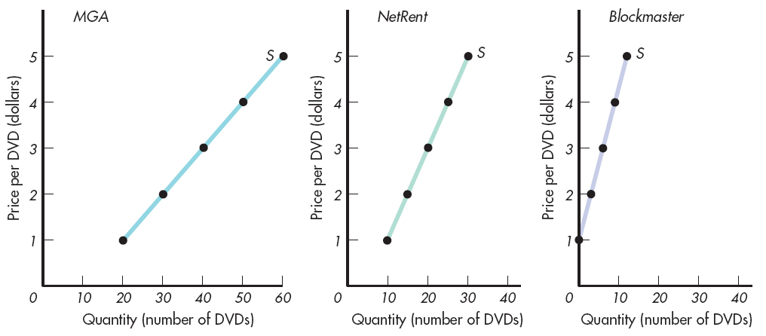
Aggregation of Supply (I)

Slide 17
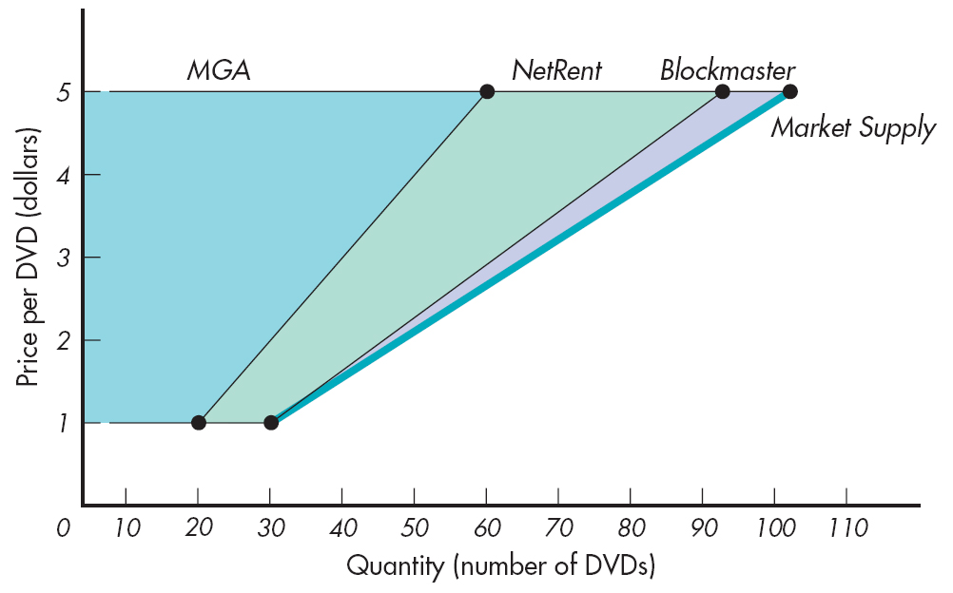
Aggregation of Supply (II)

Slide 18
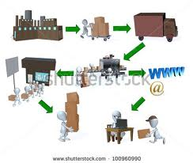
Some other determinates of Supply
Price of Related Goods or Services
If the price of alternate good changes then the opportunity cost of producing changes too!
Taxes and Subsidies
When taxes go up, costs go up, and profits go down, leading suppliers to reduce output.
When government subsidies go up, costs go down, and profits go up, leading suppliers to increase output.

Slide 19
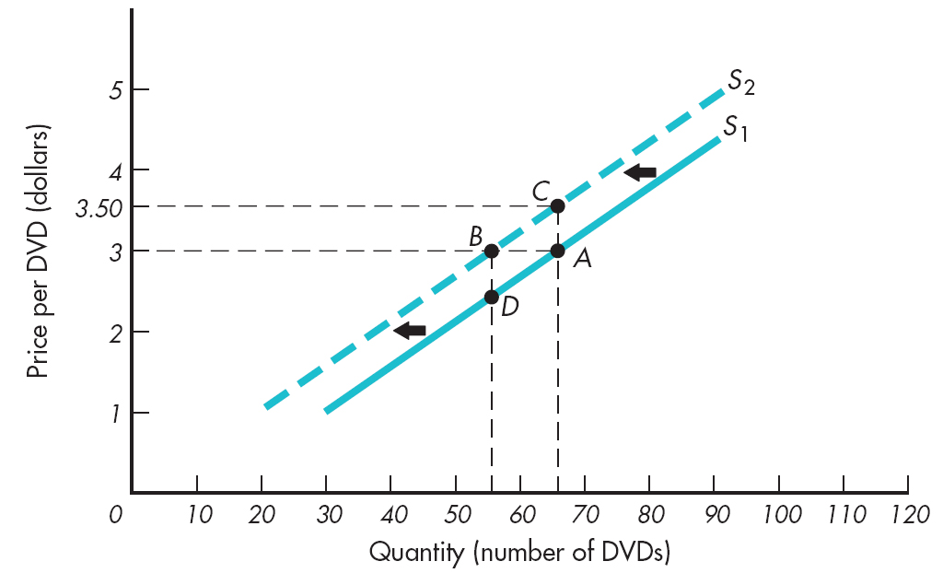
Decrease in Supply

Slide 20
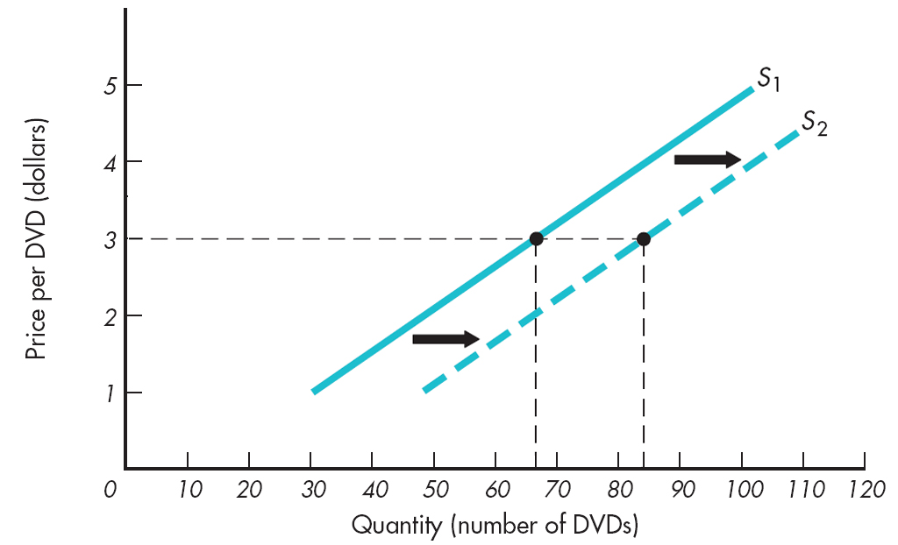
Increase in Supply

Slide 21
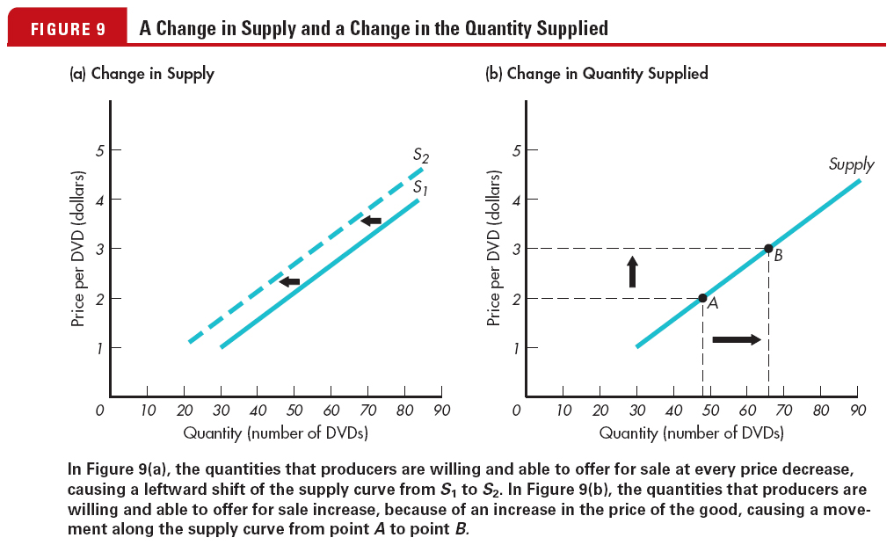
Change in Supply vs. a Change in the Quantity Supplied

Slide 22
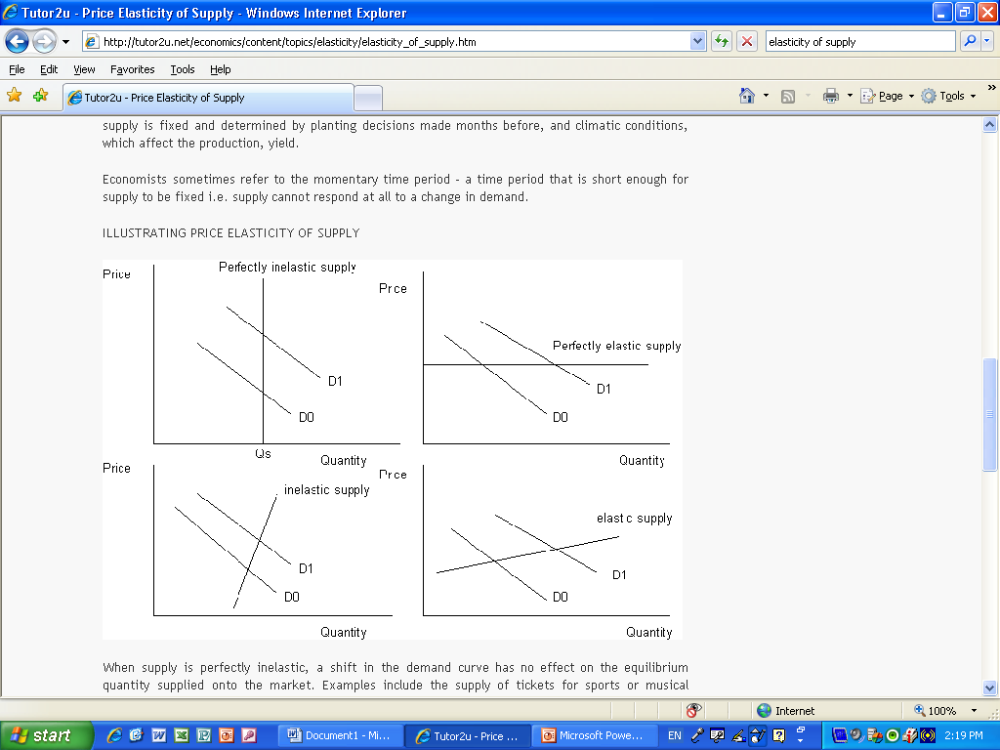
Elasticity of Supply
Elasticity of Supply: It measures the way suppliers are responding to a change in price
Elastic: sensitive/responsive to change in price (greater than 1)
Inelastic: not sensitive or not responsive to a change in price (less than 1)
Unitary: Equal change in price to equal change in supply (= to 1)

Slide 23
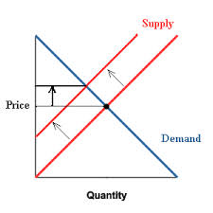
The formula of PEs
PES = percentage change in Quantity Supplied/percentage change in Price.
The supply curves all have positive slopes, so an increase in price causes an increase in quantity supplied.

Slide 24
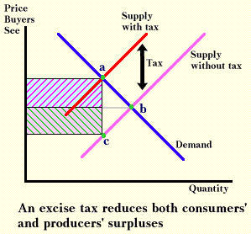
Some illustrations
p
Producers would like to charge the price P for the product (equilibrium price PLUS the tax, but market forces drive the price down to the new equilibrium price.

